Slide 1
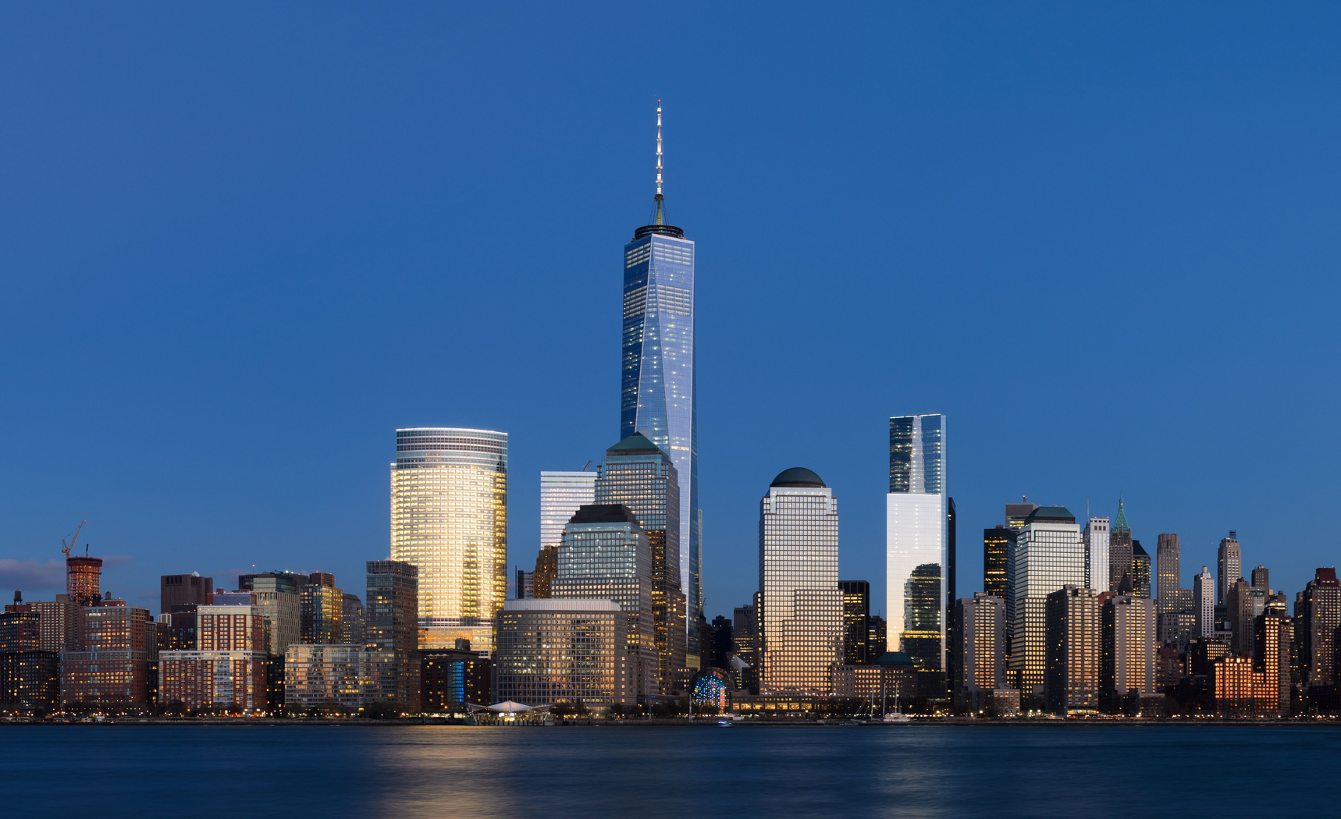
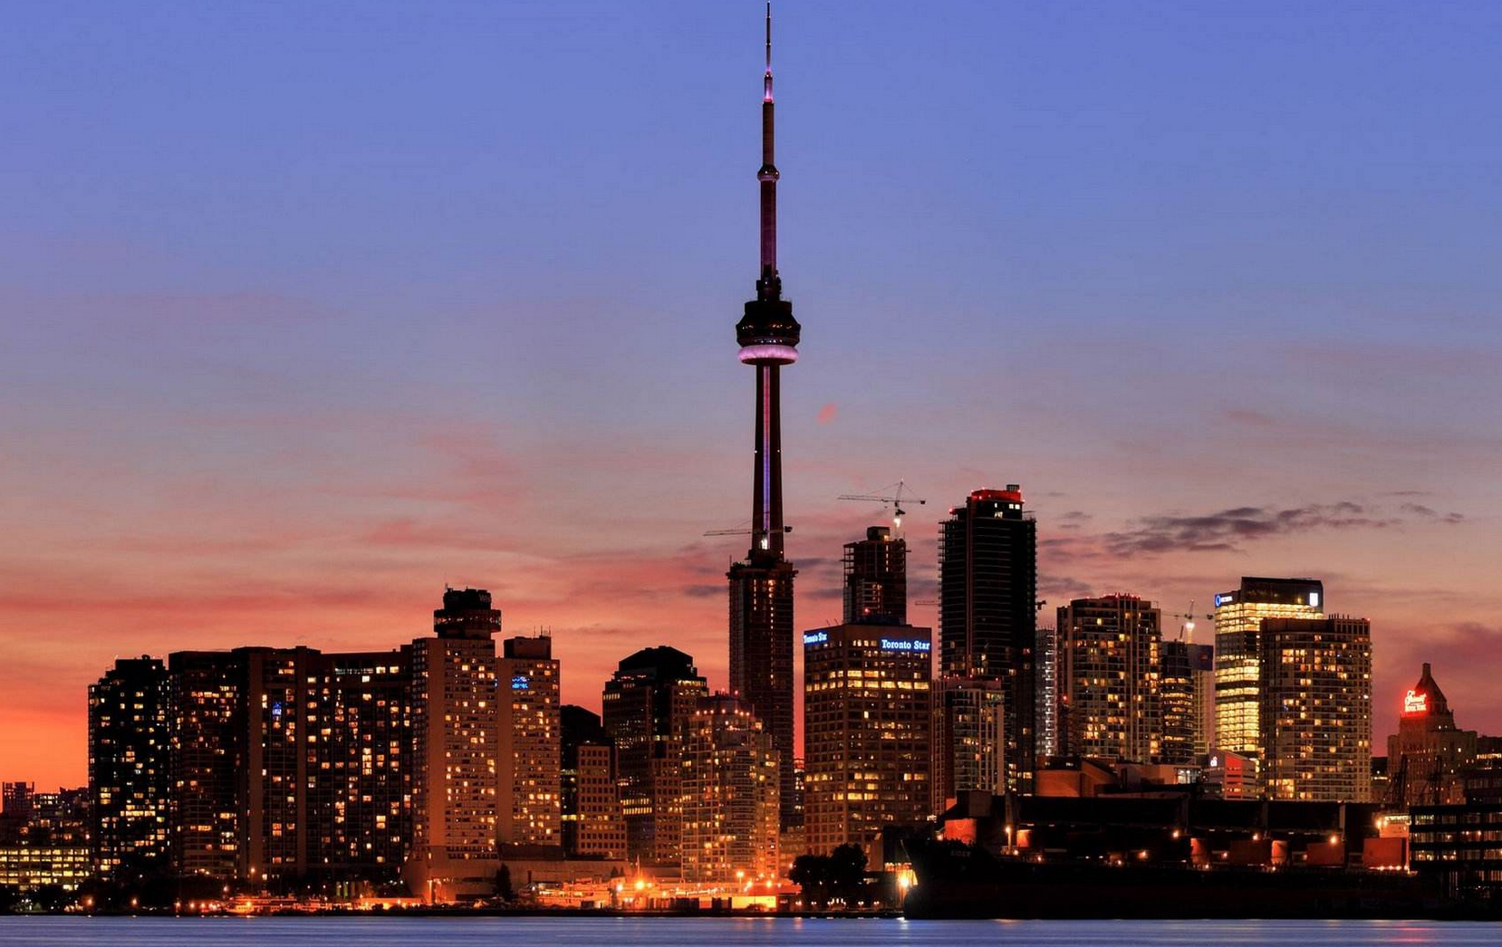
NY or Toronto，This is a choice
Comparing the neighborhoods of New York and Toronto by clustering

Slide 2
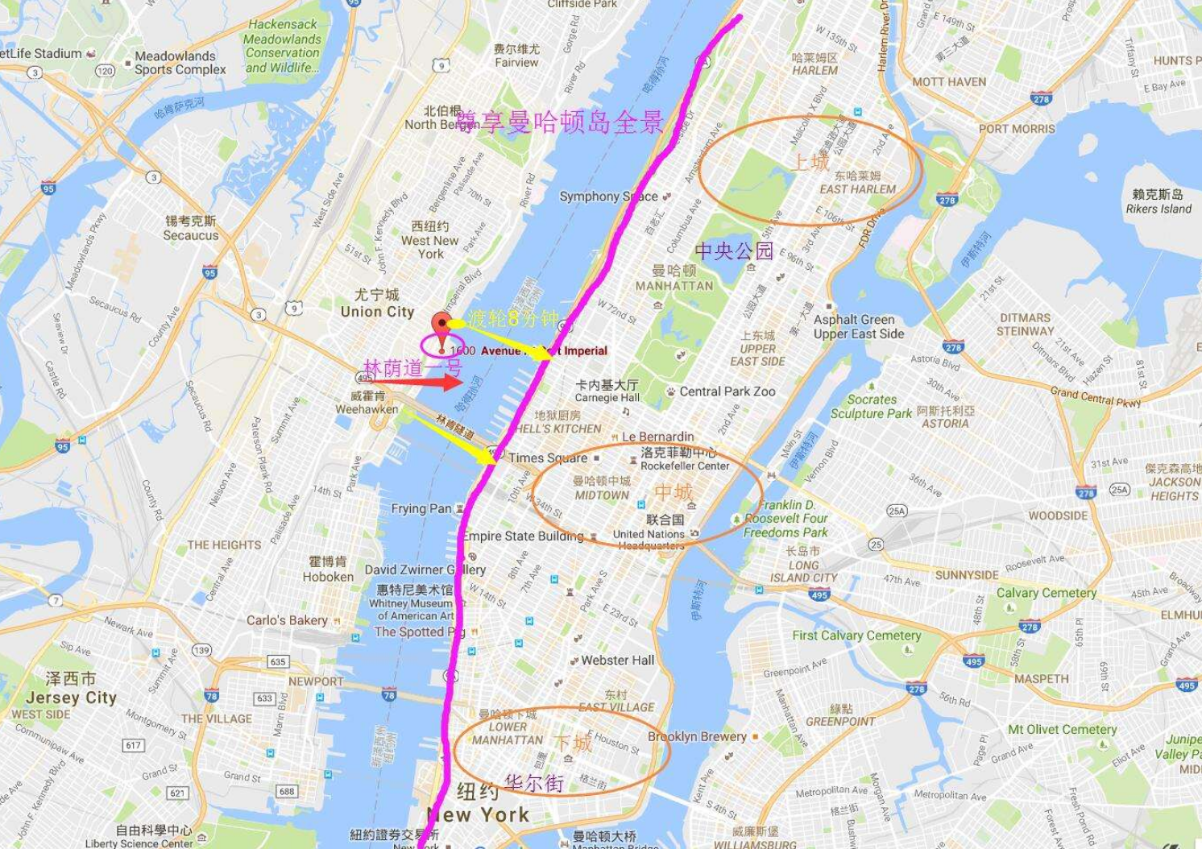
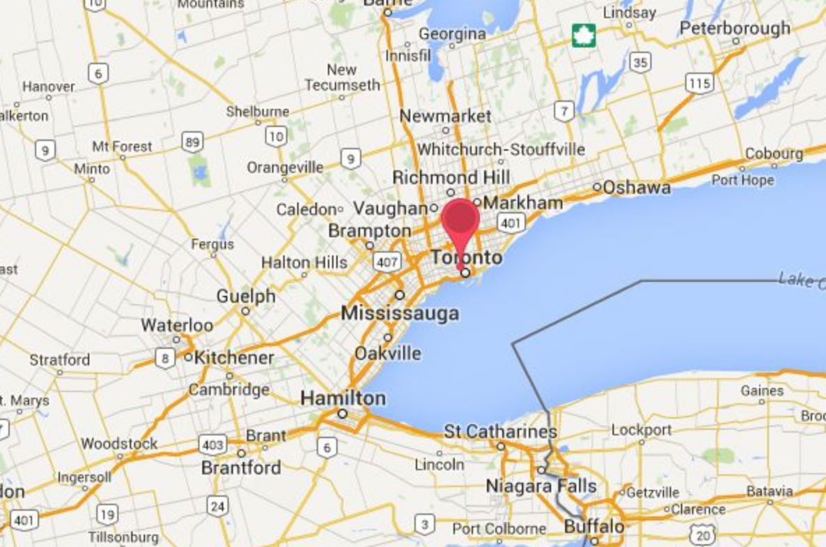
Question before vacation
I plan to have a trip in New York City or the city of Toronto. Both of them are very diverse and are the financial capitals of their respective countries.
I will explore New York City and the city of Toronto and segment and cluster their neighborhoods.
I will compare the result of clustering and decide the destination of my trip.

Slide 3
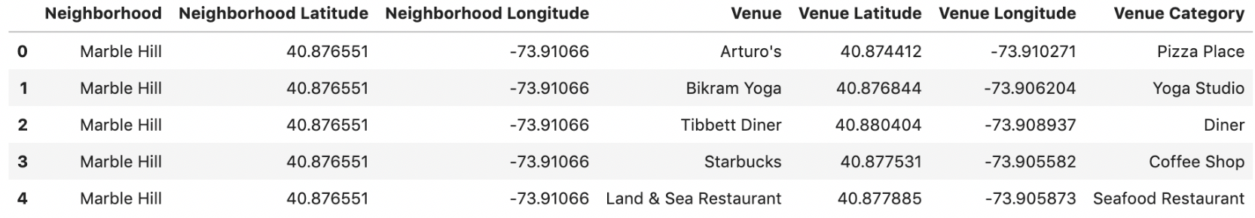

Dataset of New York
For New York city, I will simplify the dataset in Manhattan.
There are 40 Neighborhood in Manhattan
I got 3309 venue of 329 Category by Foursquare API.

Slide 4
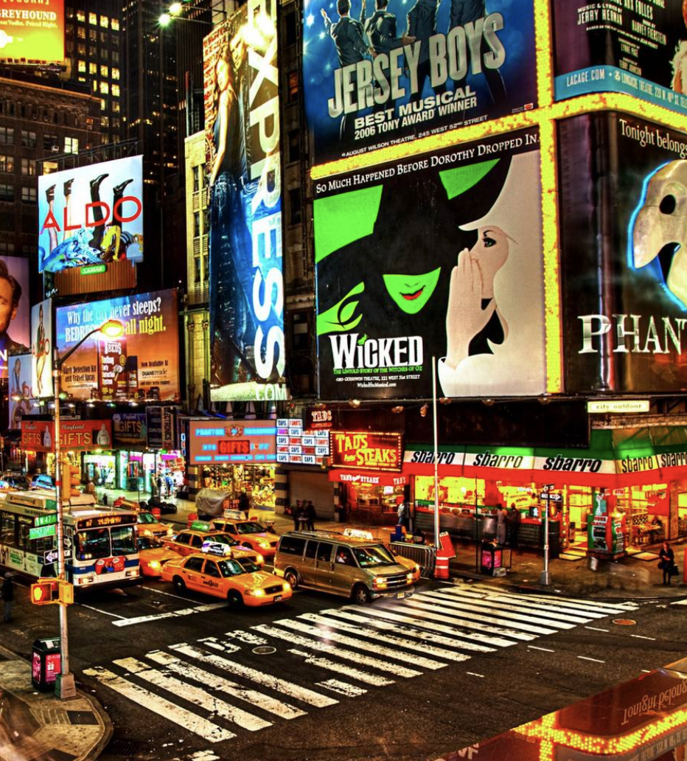
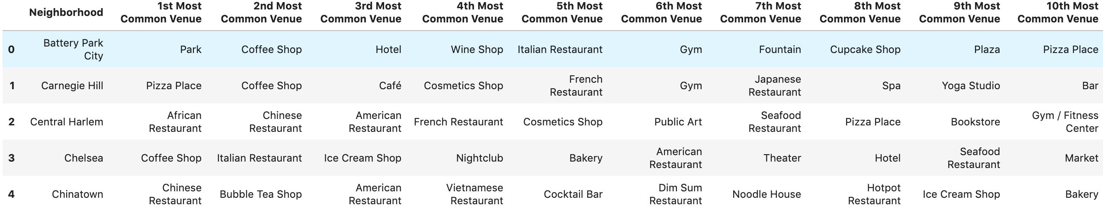
Analysis data of New York
Find the top 10 venues for each neighborhood.

Slide 5
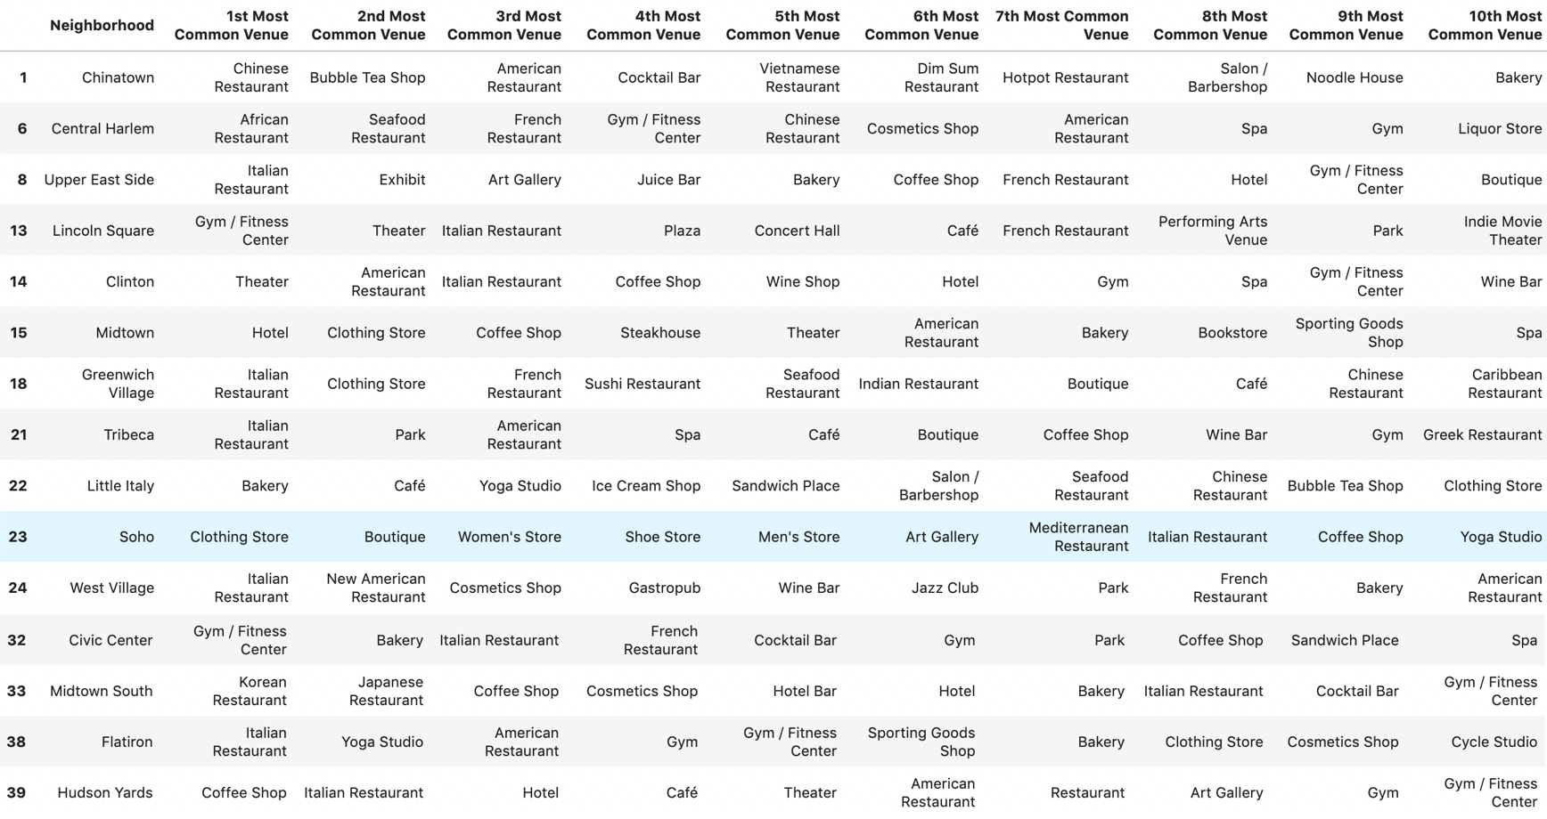
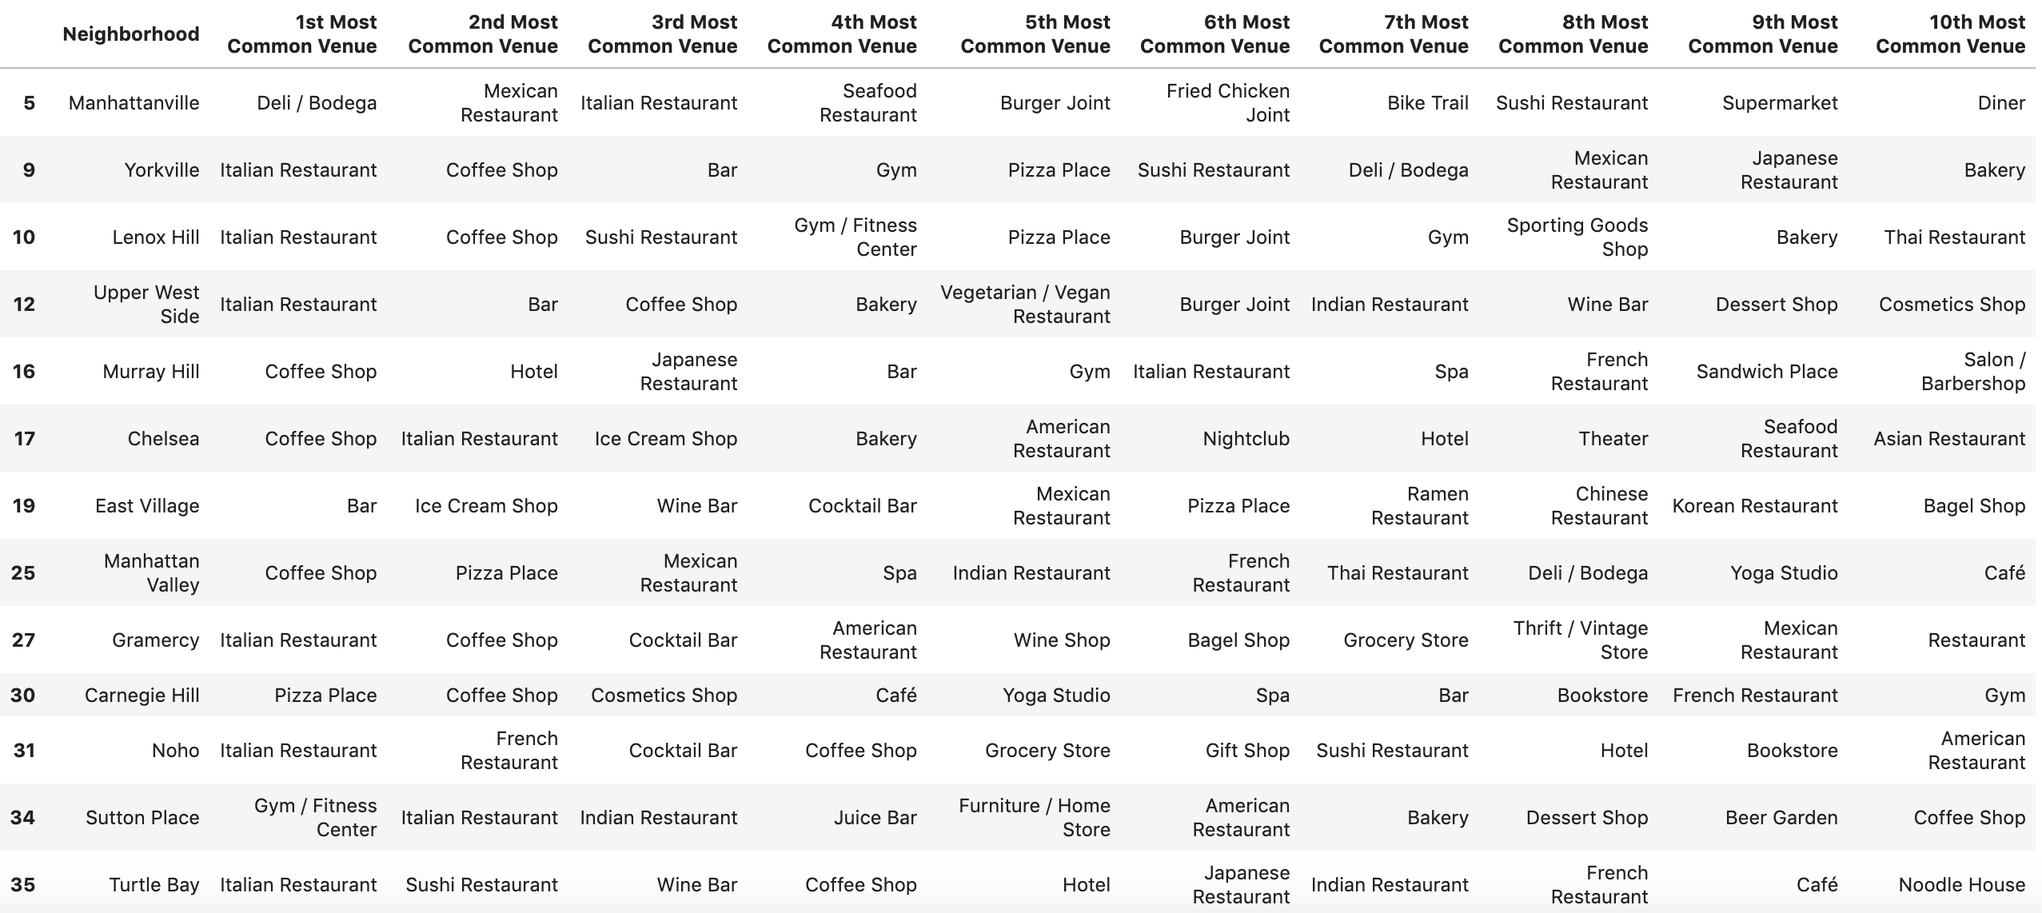
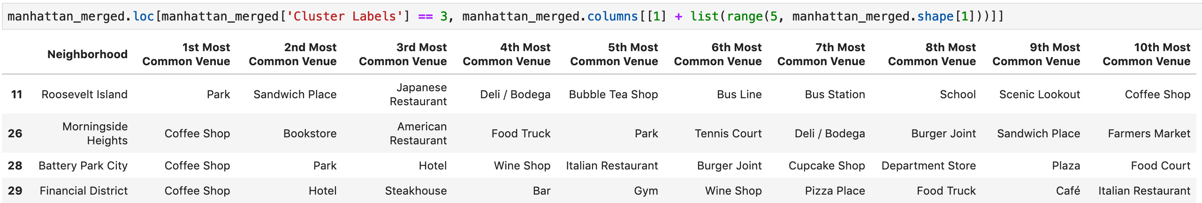
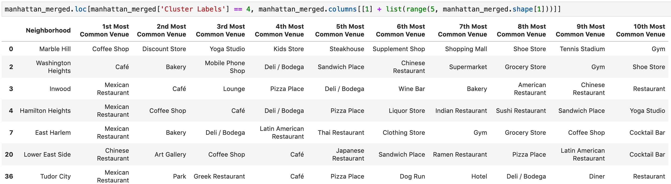
Cluster Neighborhoods of New York
Cluster 1: Food, Shopping, Art
Cluster 2: Food (Italian), Bar, Spa
Cluster 4: Coffee
Cluster 5: Food (Mexican)
Cluster 3: Sports

Slide 6

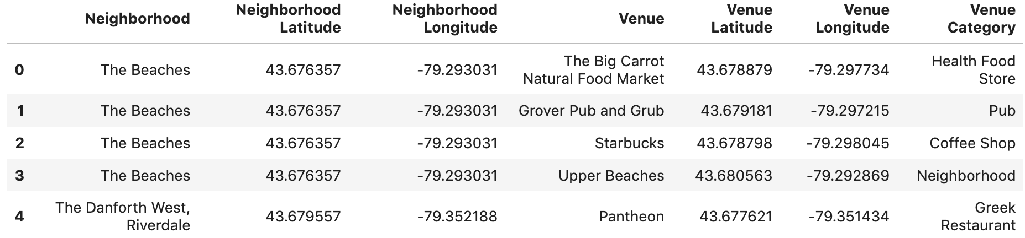
Dataset of Toronto
There are 38 Neighborhood in Toronto
I got 1692 venue of 234 Category by Foursquare API.

Slide 7
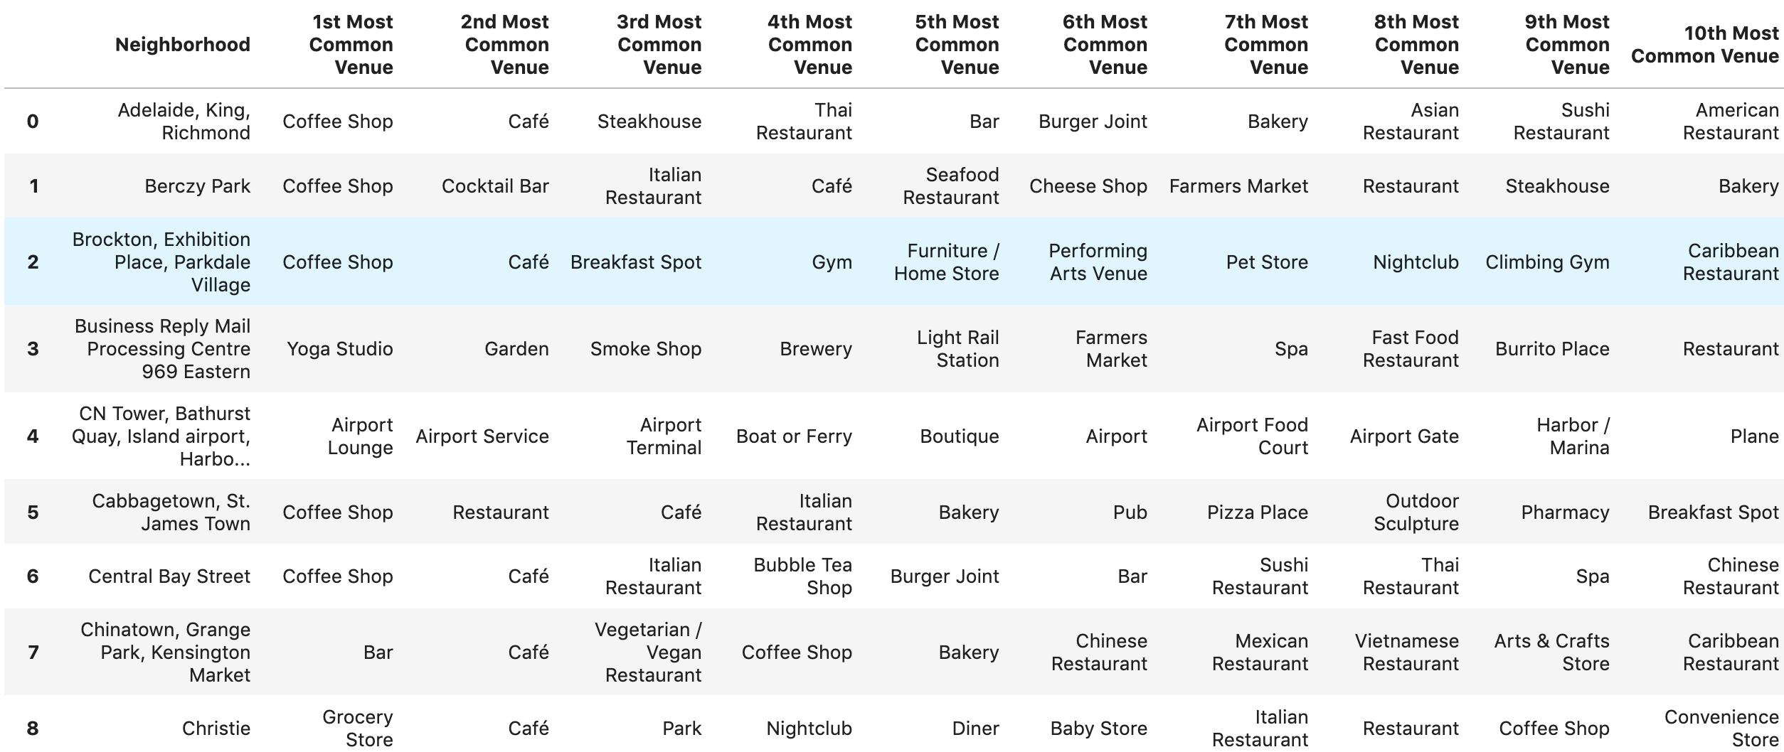
Analysis data of Toronto
Find the top 10 venues for each neighborhood.

Slide 8
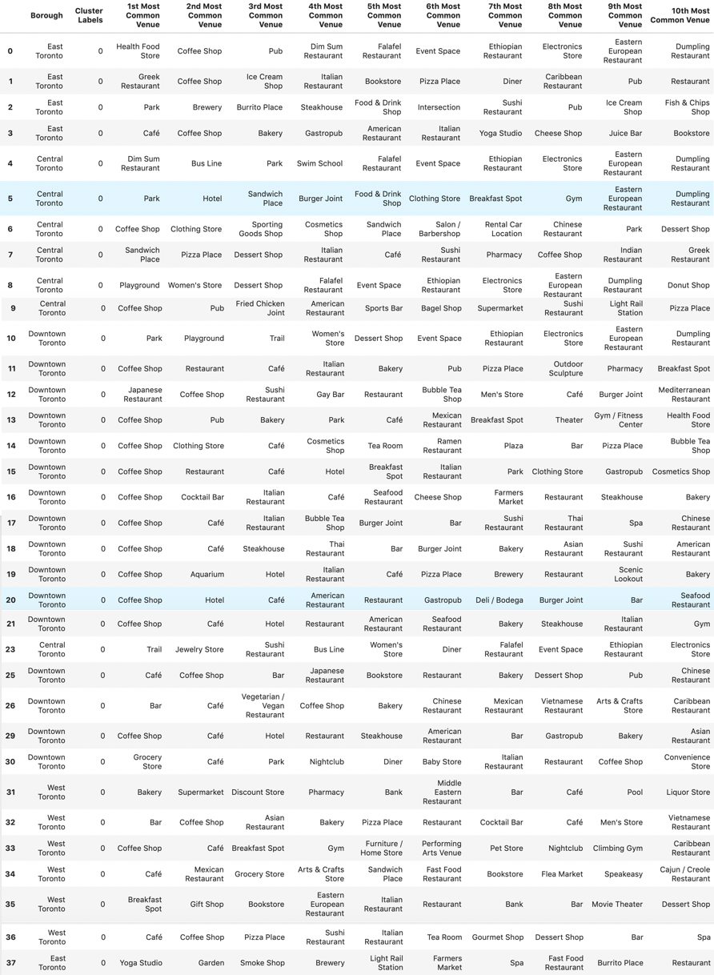
Cluster Neighborhoods Toronto
Cluster 1: Food, Coffee, pub
Cluster 2: Coffee
Cluster 3: Coffee
Cluster 4: Shopping
Cluster 5: Airport

Slide 9
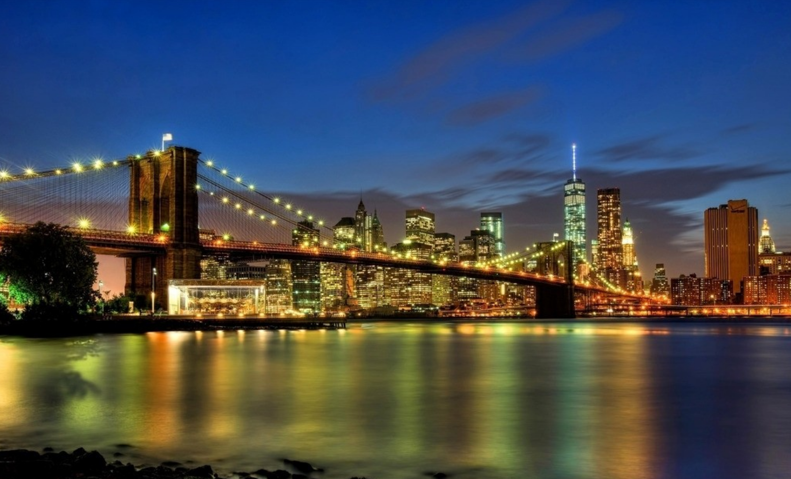
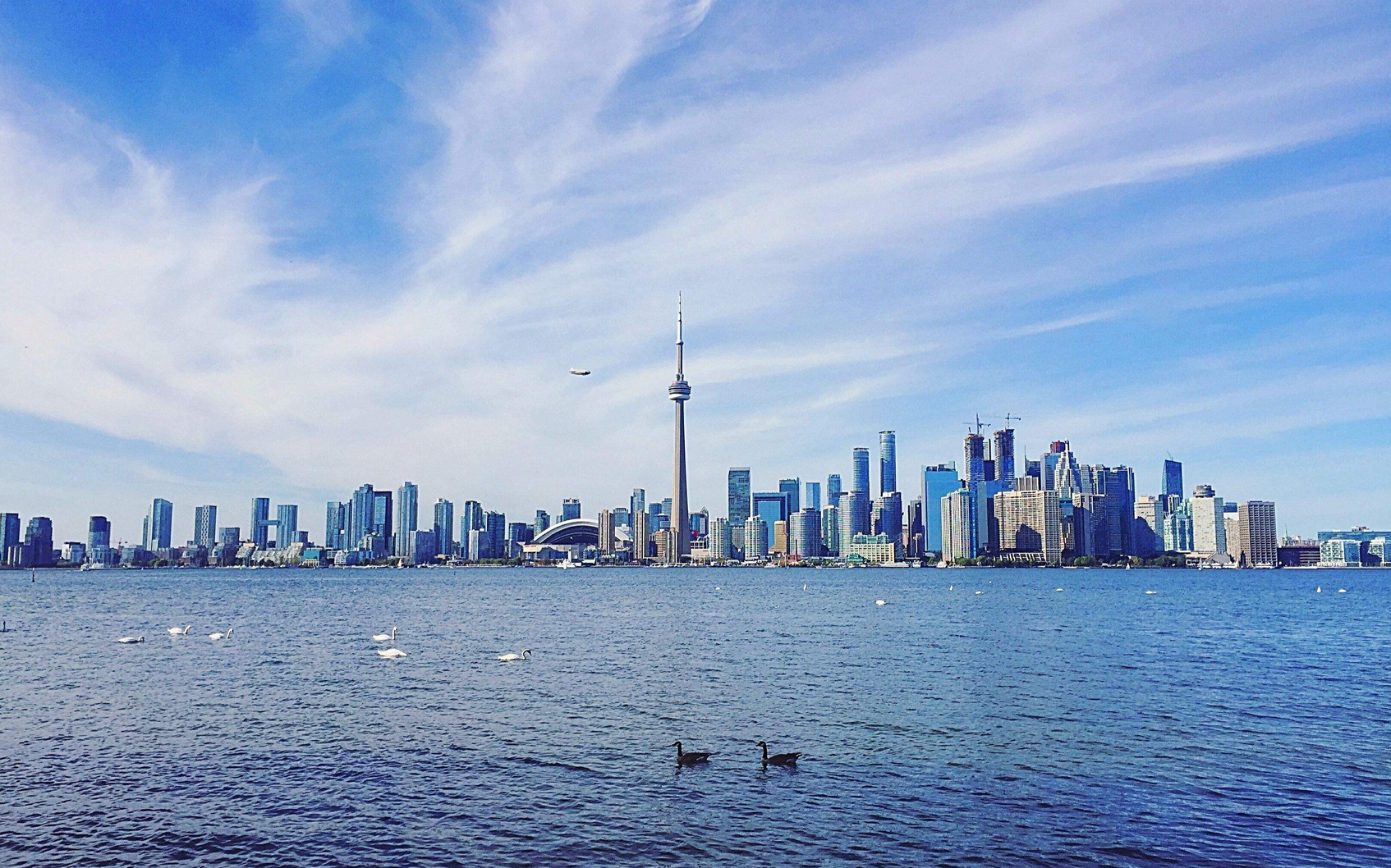
Result
From cluster result, we could see that New York is quite different from Toronto. In New York, each cluster has obvious features, such cluster1 has more shopping and art, cluster2 has more Bar and Spa. But in Toronto, different venues are evenly distributed in neighborhoods.
I plan go to New York for the vacation, epically in Neighborhoods of cluster 1 and 2.

